Slide 1

Group Mentor
Prof. Sheetal Gondal
GYM BUDDY
Your Health Companion
Python Mini Project - Group 31
Sumil Suthar 120
Sarthak Tanpure 121
Shreyas Dhamankar 113
Shaunak Rananawre 88

Slide 2
PROBLEM
STATEMENT
To provide users with an easy and convenient
way to access workout plans and track
progress.
Connect with other gym-goers for motivation.
To provide personalized workout plans based
on their fitness Levels, BMI, BMR index.
Get personalized diet plans based on their
calorie requirements.
Download your workout Session details and
share it on your Social Media platforms.

Slide 3

Why do we need this?
In todays busy lifestyle people are very ignorant
anout thier phyisical health, worrying more
about thier mental health. As a matter of fact,
physical health and mental health are very
intricately related.

Slide 4
A recent study has found that
people who exercise report
43.2%
less days of poor mental health
than who didnt exercise.
Sooner or later, we reach a point where we realize why we
shouldn't take our health for granted. And we want to help people
who are getting started on thier journey to be in their finest health.

Slide 5

OVERVIEW
User Friendly UI
Realtime Community Updates
Analytical Dashboard
Workout Tracking
Pre-crafted training routines
Personalized Diet Plan
Exercise Details
Social Media Sharing

Slide 6
OUR APPROACH
We decided to go by a GUI approach similar to
a mobile screen.
For GUI Library we decided to go with a
revamped version of Tkinter which is
CustomTkinter for better widgets and to get a
modern GUI experience.
We have used a NoSql database, MongoDB to
store the user data.

Slide 7

TECHSTACK,
SOFTWARE AND
LIBRARIES
Python
MongoDB
Pycharm
Tkinter / CTkinter
Pymongo
Regex
pillow
tk
kellanb-cryptography
pyscreenshot

Slide 8
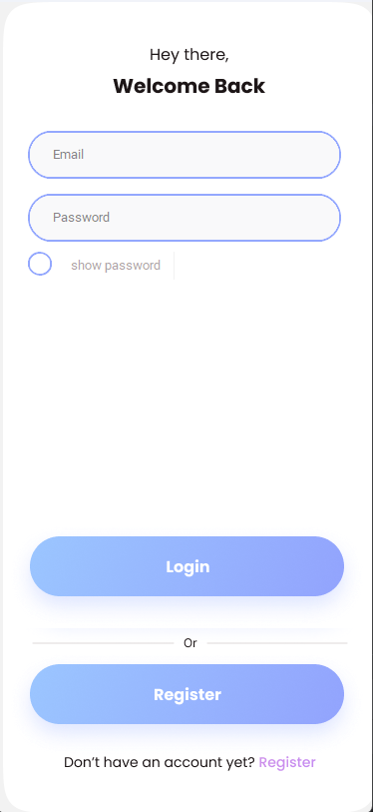
LOGIN PAGE
Emails verified using following regex
r'([A-Za-z0-9]+[.-_])*[A-Za-z0-9]+@[A-Za-z0-9-]+\.[A-Z|a-z]'
Passwords are encrypted

Slide 9
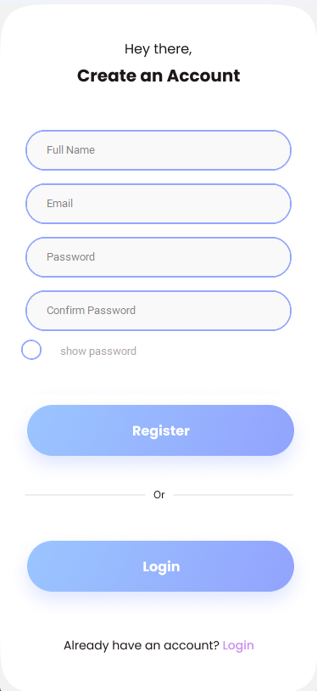
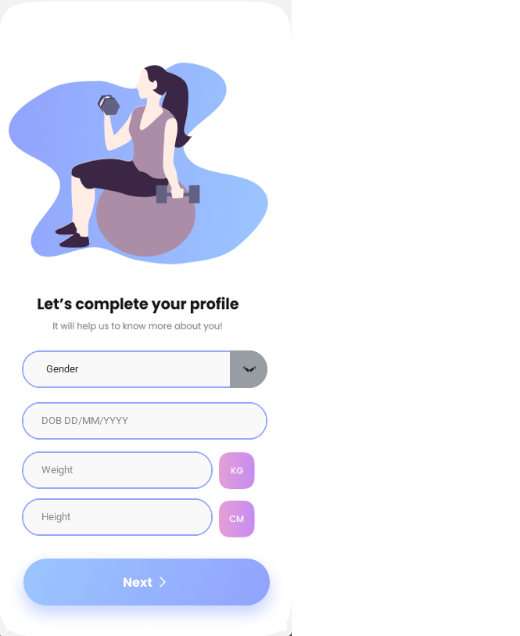
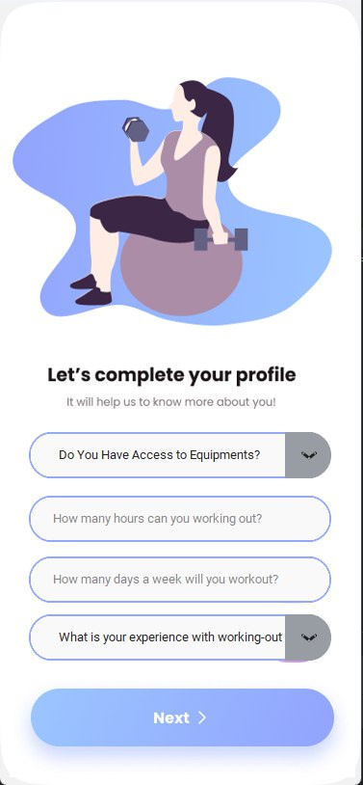
REGISTRATION PAGES

Slide 10
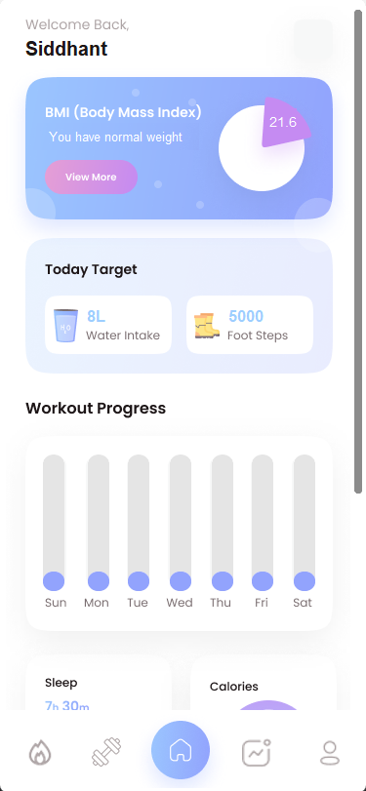
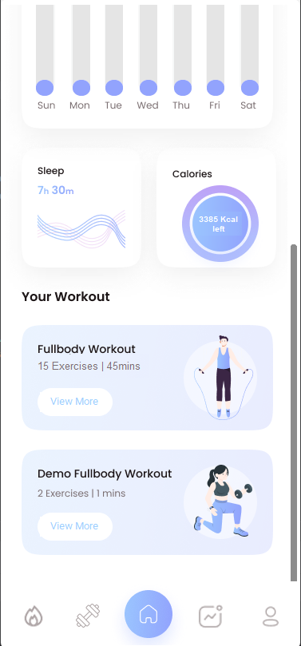
DASHBOARD

Slide 11
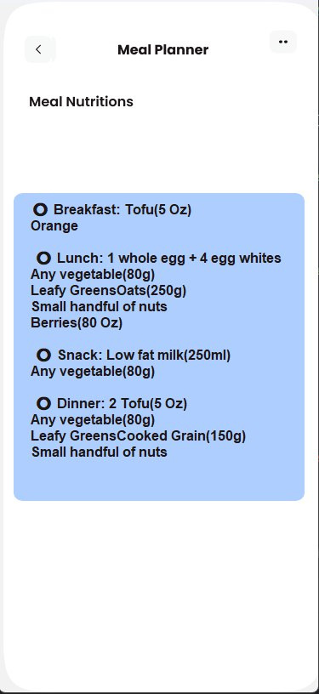
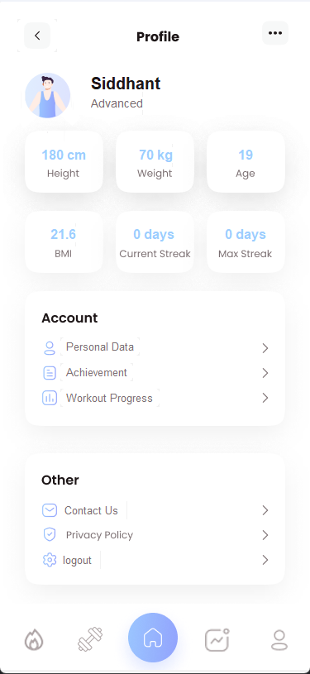
DIET PLANNER / PERSONAL INFO

Slide 12
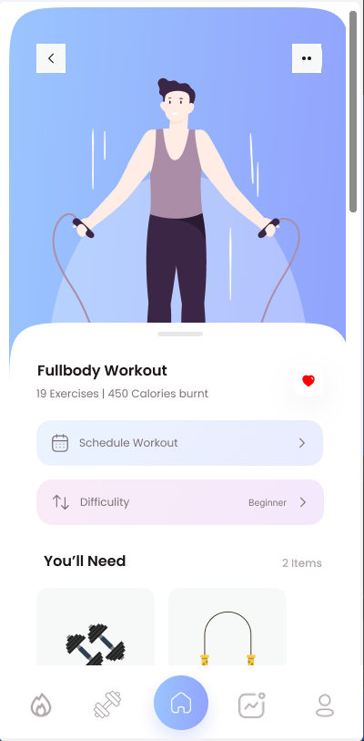
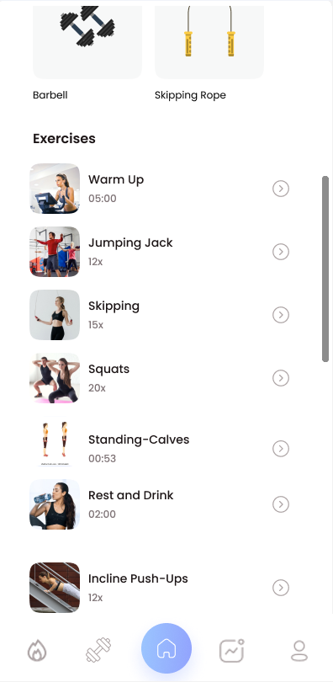
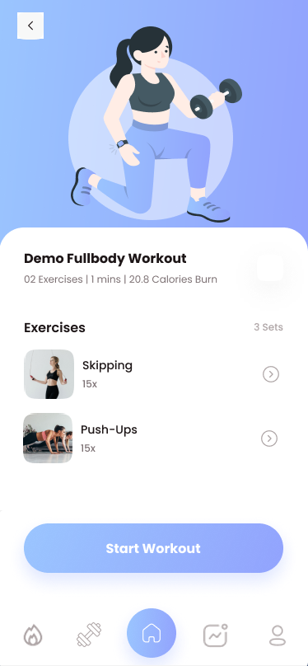
WORKOUT SECTION

Slide 13
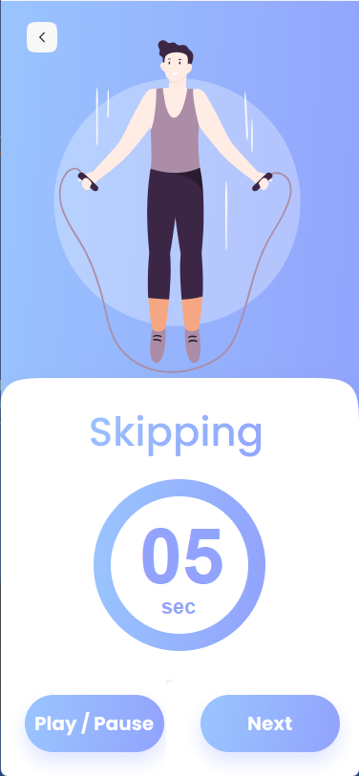

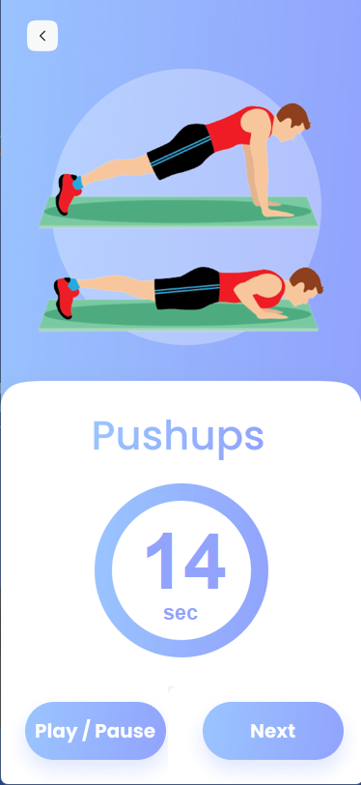
WORKOUT PLAN

Slide 14
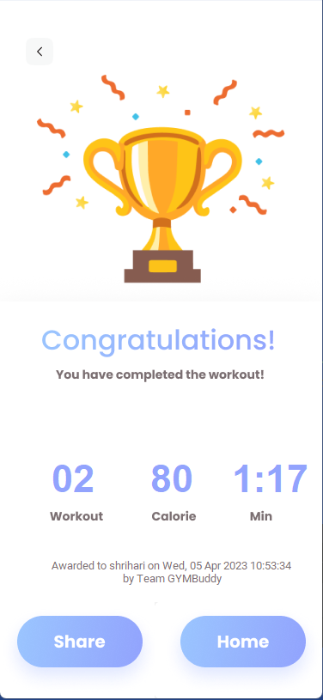
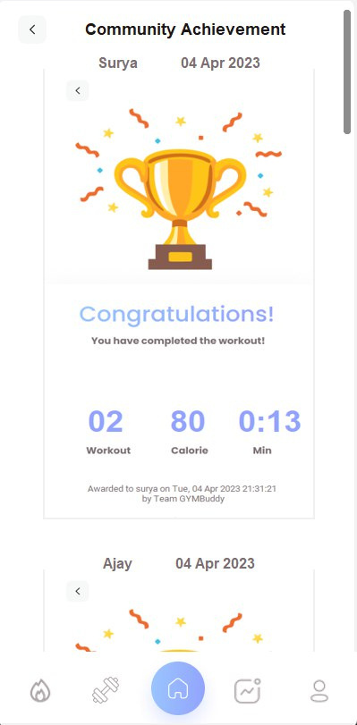
ACHIEVEMENTS

Slide 15

Thank you

